Slide 1
2019 DB Texas Symposium
Resonance

Slide 2
Intro:
10,000 students in US as of 2017 (under representation of true numbers)
87% one or two more disabilities
43% more than 4 disabilities
Notes:
The number of strictly only DB and cognitively aware is very small.
Add experience of the conference overall. Close community of caring and love-- completely inclusive environment kids, more than just interpreters

Slide 3
Day 1 DeafBlindness is an information gathering disability.
It’s about ACCESS!
What Does Access Mean Related to DeafBlindness?
Ask: Does the student have access to ongoing sensory information which is equal to that of other learners, in order to provide:
· Formal and informal learning opportunities;
· interaction with others and the environment; and
· a feeling of being connected and secure
http://intervener.org/resources/Pyramid-of-Learning-2013.pdf
Notes:
Page 5 from Day 1 (printed and on sign in table.)

Slide 4
Day 2: Keynote: The Power of Acceptance and Positivity
Chris Ulmer: Founder and CEO of Special Books by Special Kids
Chris has made it his life’s mission to normalize the diversity of the human condition by showcasing how understanding, positivity, and acceptance can make a better world for all. Special Books by Special Kids
https://www.facebook.com/sbskchris
The first question he always starts with: “What do you want the world to know about you?” (An open ended question)
Notes:
He was a classroom teacher for many years that started making these videos with students in his classroom. Then it started growing. To date he has interviewed over 1,000 people.
He really spoke about: FOCUSING ON THE SIMILARITIES, NOT ON THE DIFFERENCES!

Slide 5
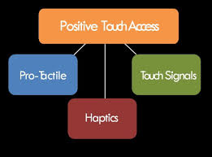
Day 2 continued…..Touch Signals: A generic term that refers to all systems of providing visual and environmental information through touch.
Pro-Tactile: A philosophy and a movement which focuses on autonomy and equality for people who are deaf-blind. PT is much more than a system of touch signals. Provides visual and environmental information through touch, namely back-channeling. Very popular in Seattle.
Haptics: A standardized system of providing visual and environmental info via touch on the body
Notes:
Protactile: The purpose of PT philosophy is to support DB culture, language, interpersonal relationships, politics, and a true sense of empowerment. It is signed: “P T”
Haptics is signed: Left hand CL:5 handshape and right hand using all fingers walking up and down the palm
INTERPRETERS, INTERVENERS, SSP (SUPPORT SERVICE PROVIDER) ALL SUPPORT EACH OTHER BUT HAVE DIFFERENT ROLES

Slide 6
Day 3: Assessments: Closing Keynote: David Brown, DB Consultant from CA
Communication Matrix: a communication skills assessment designed for the parent and professional to evaluate communication in individuals with disabilities. It is unique in measuring all possible communicative behaviors in non-speaking individuals and accommodates any type of communicative behavior, including augmentative and alternative forms of communication, pre-symbolic communication and typical forms of communication such as speech and writing.
Home Talk:an assessment tool for parents and care providers who are deafblind and who have other disabilities. Its purpose is to help families participate in the planning of their child’s educational program. It will help to: 1) develop an IEP 2) review student’s progress and needs at a school meeting 3) introduce the student to new staff members, and 4) summarize important information about the student.
Informal Functional Hearing Evaluation (IFHE) can provide information about how the child is currently using his/her hearing in a variety of settings and then guide the IEP team in developing instructional strategies to address the child’s dual sensory needs. It can document concerns when a student is unable to participate in formal testing (a lack of formal language, health issues, or concerns regarding sedation to test for an auditory brainstem response (ABR).It can help shape programming considerations for a student with deafblindness. It also can serve as a guide for determining what accommodations are needed in the classroom, home, and community environments to promote student access to information. IFHE can be used as a compliment before formal testing to provide valuable information to the audiologist or ENT. IFHE should not serve as sole documentation of hearing impairment; formal testing is needed.

Slide 7
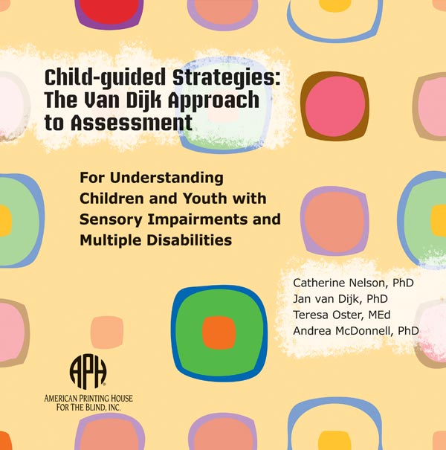
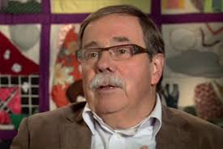
Jan van Dijk: Pioneer in deaf blindness
Notes:
Child-guided Strategies: The Van Dijk Approach to Assessment
This product offers an easy-to-use guidebook with an accompanying flash drive that follows the assessment of a baby, a young child, and a teenager. The Van Dijk assessment is unique as it follows the lead of the individual learner. Critical to the process is the recognition that assessment and intervention must always occur hand in glove and that meaningful assessment guides intervention.
OBSERVATION: WE DON’T OBSERVE ENOUGH. IF YOU WANT TO SEE A SKILL GROW,YOU HAVE TO PRACTICE IT!
ALSO.. HE GAVE AN EXAMPLE WHICH WAS A GOOD REMINDER TO US ALL ABOUT ASSESSMENTS AND WORDING. HE READ A REPORT IN WHICH THE WORDING OF THE ASSESSMENT WAS VERY NEGATIVE: THE CHILD REFUSES TO….. AND HE RE-WORDED IT TO BETTER REPRESENT THE POSITIVE.

